Slide 1

DEPARTMENT OF COMPUTER SCIENCE & ENGINEERING
SCHOOL OF COMPUTING
10214CS601 MINOR PROJECT -1
SUMMER SEMESTER(2025-2026)
REVIEW-II
“Real-Time Emotion-Based Music Recommendation Web App”
SUPERVISED BY
PRESENTED BY
Dr. V. Jeevanantham,BE,ME,PhD,
AssociateProfessor
1.PAPAREDDY ABITHA (VTU 24593)(23UECS1167)
2.PEMMASANI SWATHI (VTU 24653)(23UECS1176)
3.PARVATAREDDY SRAVYA (VTU 24717)(23UECS1170)

Slide 2
OVERVIEW
ABSTRACT
OBJECTIVE
INTRODUCTION
LITERATURE REVIEW (SOFT COPY OF PAPERS TO BE LINKED AS HYPERLINK)
DESIGN AND METHODOLOGIES
IMPLEMENTATION
TESTING
INPUT AND OUTPUT
INCLUDE DEMO VIDEO-1 (Till REVEW-1)
INCLUDE DEMO VIDEO-2(Complete Implementation of Project)
CONCLUSION
WEB REFERENCES LINK (TILL REVIEW DATE ALL LINKS TO BE INCLUDED DAY WISE)
PLAGIARISM REPORT OF PPT
REFERENCES

Slide 3
ABSTRACT
INTRODUCTION
A Real-Time Emotion-Based Music Recommendation Web App is a system designed to personalize music suggestions based on the user's emotional state at the moment of interaction.
This innovative approach to music recommendation goes beyond traditional playlist algorithms by integrating real-time emotion recognition through technologies like facial expression analysis, voice tone detection, and text sentiment analysis.
It uses AI to detect your current mood and instantly suggest music that matches your emotional state.

Slide 4
PURPOSE
Recommends music based on the user's current emotional state
Enhances user experience by aligning music with mood in real time
Enhance Emotional Connection with Music Tailors music suggestions to match or influence the user's current emotional state.
METHODS
Facial Expression Analysis: Uses computer vision (e.g., OpenCV, deep learning models) to interpret emotions from webcam input.
Voice Tone Analysis: Applies audio processing and ML (e.g., MFCC features + emotion classifiers) to detect mood from speech.

Slide 5
RESULT
Accurate Emotion Detection: Real-time identification of user emotions through facial, voice, or text input.
Dynamic Music Suggestions: Immediate playlist updates that reflect the user's current mood.
User Engagement: Increased interaction and satisfaction due to personalized music experiences.
CONCLUSION
Emotion-aware music recommendation represents a powerful fusion of AI and human-centered design.
The app delivers a deeply personalized experience, adapting music to real-time emotional shifts.
It offers practical benefits for mental wellness, entertainment, and user engagement.

Slide 6
OBJECTIVES
Aim of the Project
To develop an intelligent music recommendation system that responds to users' emotional states in real time.
To enhance user experience by offering music that aligns with or helps regulate their current mood.
To integrate emotion recognition technologies (facial, voice, or text-based) with music recommendation engines.
Scope of the Project
Emotion Detection Modalities Incorporates facial expression, voice tone, and text sentiment analysis to identify user emotions in real time.
Music Recommendation System Maps detected emotions to music genres, moods, and tracks using metadata and machine learning models.
Real-Time Interaction Continuously updates music suggestions as the user's emotional state changes during the session.

Slide 7
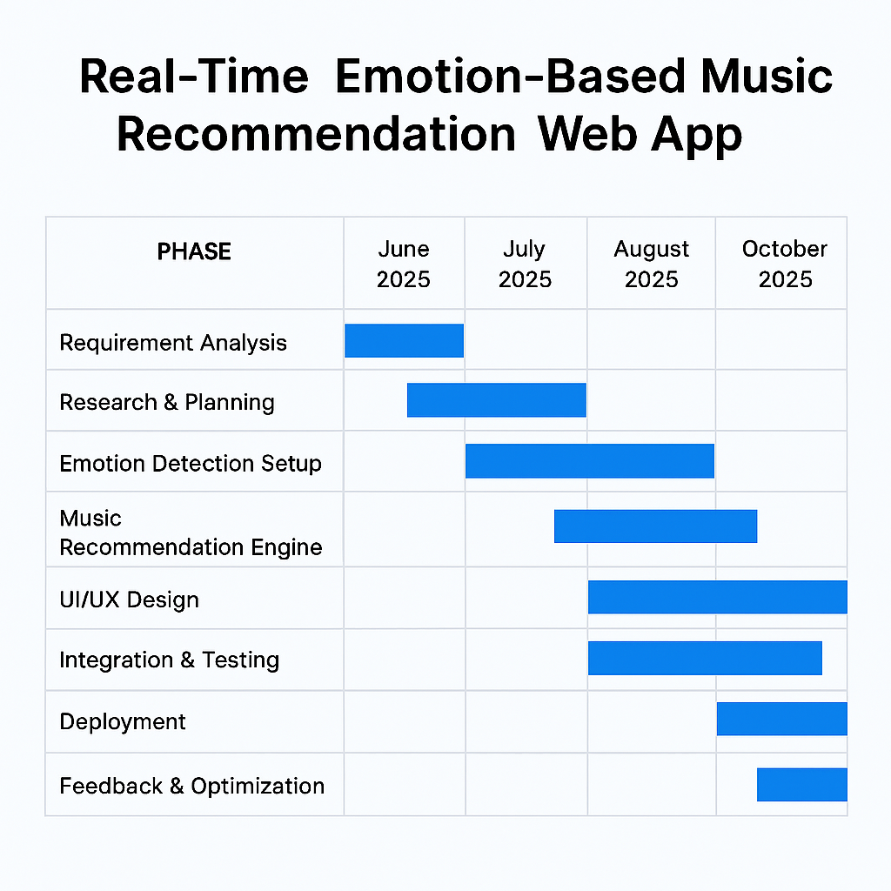
TIMELINE OF THE PROJECT
Sample Gantt Chart

Slide 8
INTRODUCTION
Brief Overview
“Music is the shorthand of emotion.” — Leo Tolstoy. What if your playlist could read your mood before you even press play?
This project aims to create a web application that detects a user's emotional state in real time and recommends music that matches or improves their mood.
It blends artificial intelligence, psychology, and music theory to deliver a deeply personalized listening experience.
Background Information
Traditional music apps rely on user history, genre preferences, or manual searches.
Emotional states are dynamic—what feels right one moment may not the next.
Advances in AI now allow systems to interpret facial expressions, voice tone, and text sentiment to infer emotions.
Examples and Instances
A student feeling anxious before an exam might receive calming lo-fi beats to ease tension.
A user expressing joy through a smile or upbeat tone could be served energetic pop or dance tracks.
Apps like Moodify and Emotify have explored emotion-based music curation, but few offer real-time responsiveness.

Slide 9
LITERATURE REVIEW
Sl.No | Author’s Name | Paper name and publication details | Year of publication | Main content of the paper
1 | S. Dhanawade et al. | Emotion-Based Music Recommendation System, IEEE Conference Publication | 2021 | Uses facial expression analysis and neural networks to recommend mood-aligned music.
2 | A. Sharma et al. | Affective Music Recommendation Using Multimodal Emotion Recognition, IEEE Transactions | 2022 | Combines facial, voice, and text inputs using deep learning fusion for emotion detection
3 | R. Mehta et al. | Real-Time Emotion-Aware Music Recommendation Using Deep Learning, IEEE Access | 2023 | Proposes CNN-LSTM hybrid model for real-time emotion classification and music mapping
4 | P. Kumar et al. | Personalized Music Recommendation Based on EEG and Facial Emotion Recognition, IEEE Sensors J. | 2022 | Integrates EEG and facial data to personalize music recommendations using biofeedback.

Slide 10
5 | N. Verma et al. | Emotion-Aware Music Recommendation Using BERT and Audio Features, IEEE ICME | 2024 | Uses BERT for text sentiment and MFCC for audio emotion to suggest emotionally
6 | M. Iqbal et al. | Context-Aware Music Recommendation Based on Emotion and Activity Recognition, IEEE Trans. MM | 2023 | Adds activity context (e.g., walking, studying) to emotion detection for smarter suggestions.
7 | T. Balakrishnan et al. | Deep Emotion Recognition Using Facial Micro-Expressions, IEEE ICCVW | 2025 | Focuses on subtle facial cues for emotion detection and refined music matching.
8 | K. Singh et al. | Emotion-Driven Music Recommendation Using Reinforcement Learning, IEEE TNNLS | 2025 | Applies reinforcement learning to adapt music recommendations based on emotional feedback.

Slide 11
DESIGN AND METHODOLOGIES
The Project contains the following Main Modules:
MODULE 1:User interface module
MODULE 2:Emotion Detection module
MODULE 3:Emotion Classification module
MODULE 4:Database module

Slide 12
MODULE 1:User interface module
Provides a responsive web interface for user interaction
Displays detected emotions and recommended music
Accepts inputs via webcam, microphone, or text box
MODULE 2:- Emotion Detection Module
Facial Expression Analysis using computer vision (e.g., OpenCV, CNN)
Voice Tone Analysis using audio features (e.g., MFCC, pitch)
Text Sentiment Analysis using NLP models (e.g., BERT, VADER)

Slide 13
MODULE 3:- Emotion Classification Module
Aggregates multimodal inputs
Classifies emotions into categories like happy, sad, angry, relaxed
Uses ML models such as SVM, Random Forest, or deep learning (CNN, LSTM)
MODULE 4:- Classification Module
Aggregates multimodal inputs
Classifies emotions into categories like happy, sad, angry, relaxed
Uses ML models such as SVM, Random Forest, or deep learning (CNN, LSTM)
Eg,
It’s a sample only and may vary according to the project

Slide 14
Algorithm Description
Step 1: Image Input
User uploads an image via UI.
Image sent to /api/emotion/detect endpoint.
Step 2: Emotion Detection
DeepFace analyzes facial features.
Returns emotion label + confidence score.
Step 3: Music Recommendation
Emotion label passed to /api/music/recommendations/<emotion_id>.
Backend retrieves matching playlist from local music catalog.
Step 4: Playlist Generation
Playlist includes track metadata: title, artist, duration, cover art.
Displayed in UI with playback controls.
Step 5: User Interaction
User plays, likes, or navigates tracks.
Emotion detection history is stored with timestamps.

Slide 15
IMPLEMENTATION
Architecture Diagram
Data –Flow Diagram
Use Case Diagram
Class Diagram
Activity Diagram
Sequence Diagram
Collaboration Diagram(If applicable)
E-R Diagram
It’s a sample only and may vary according to the project

Slide 16
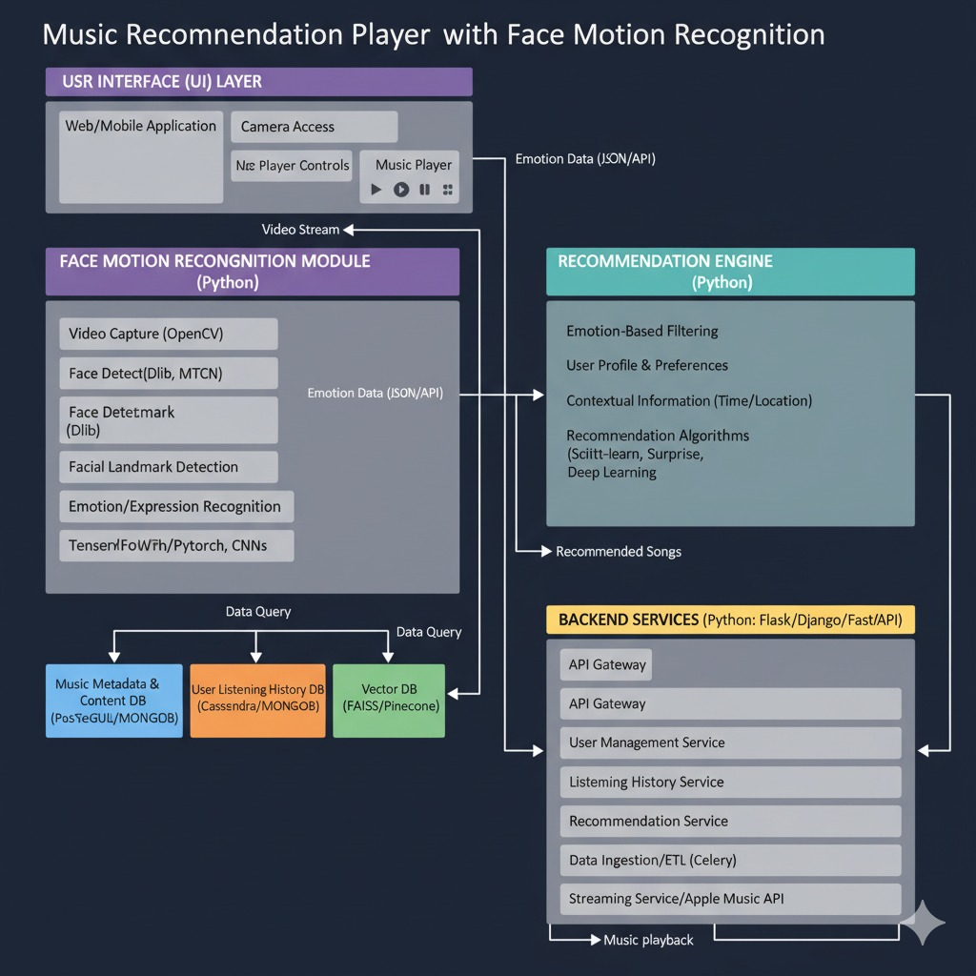
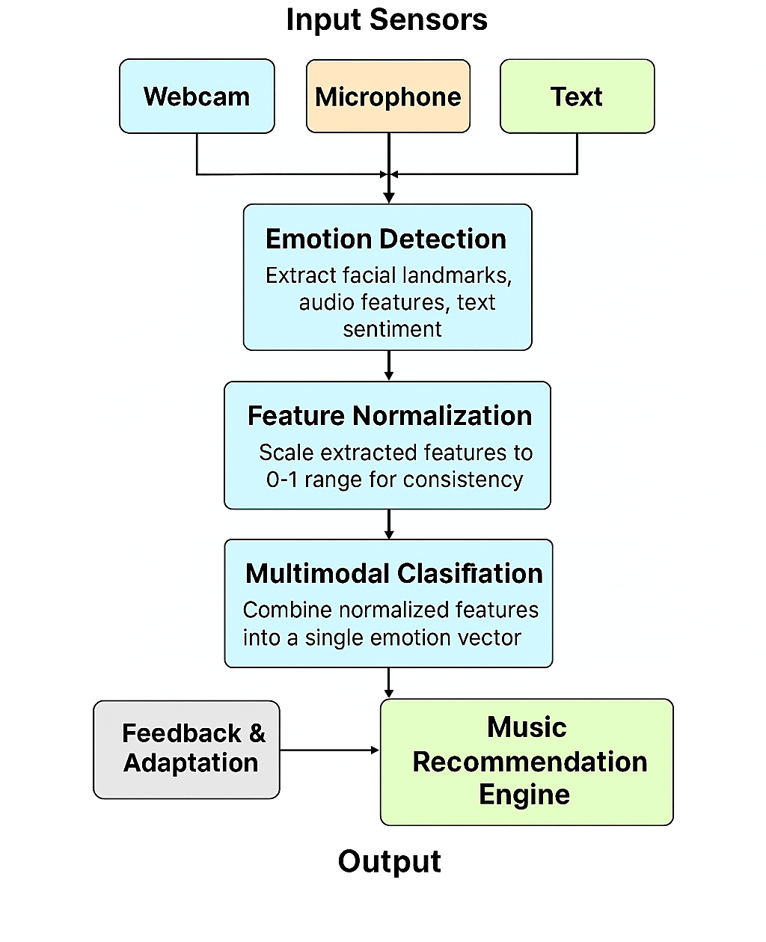
Architecture Diagram

Slide 17
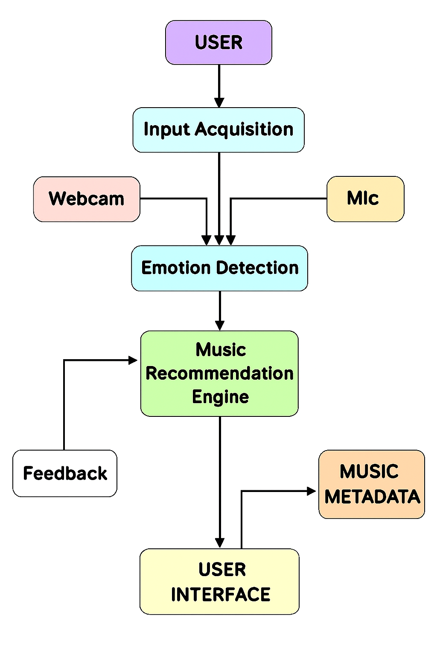
Data –Flow Diagram
Real-Time Emotion-Based Music Recommendation Web App Data flow diagram

Slide 18
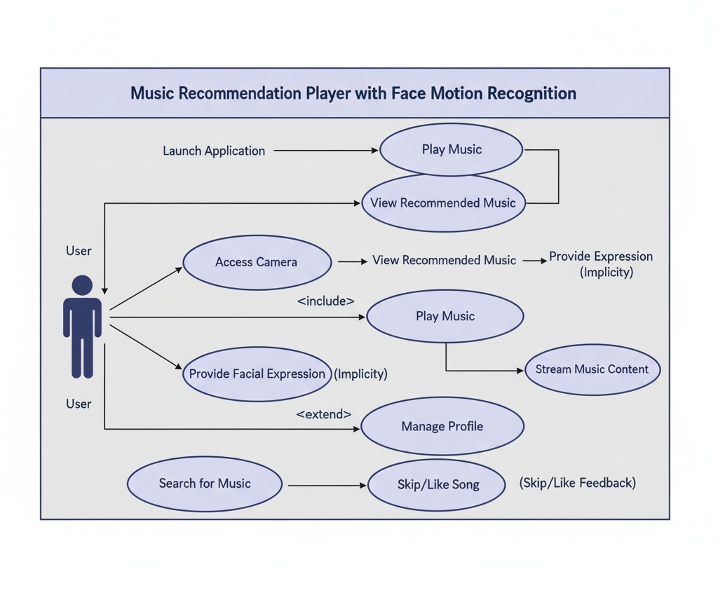
Use Case Diagram
,

Slide 19
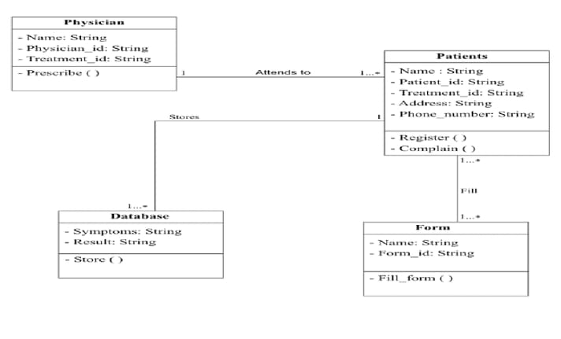
Class Diagram

Slide 20
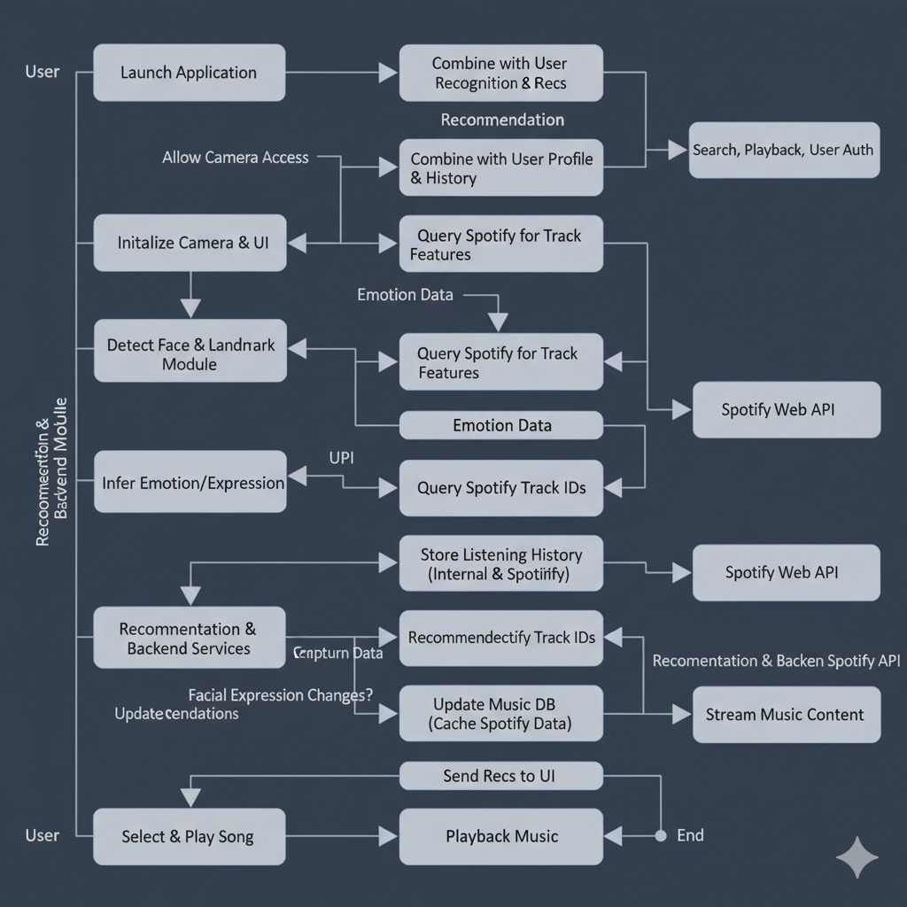
Activity Diagram
Eg,

Slide 21
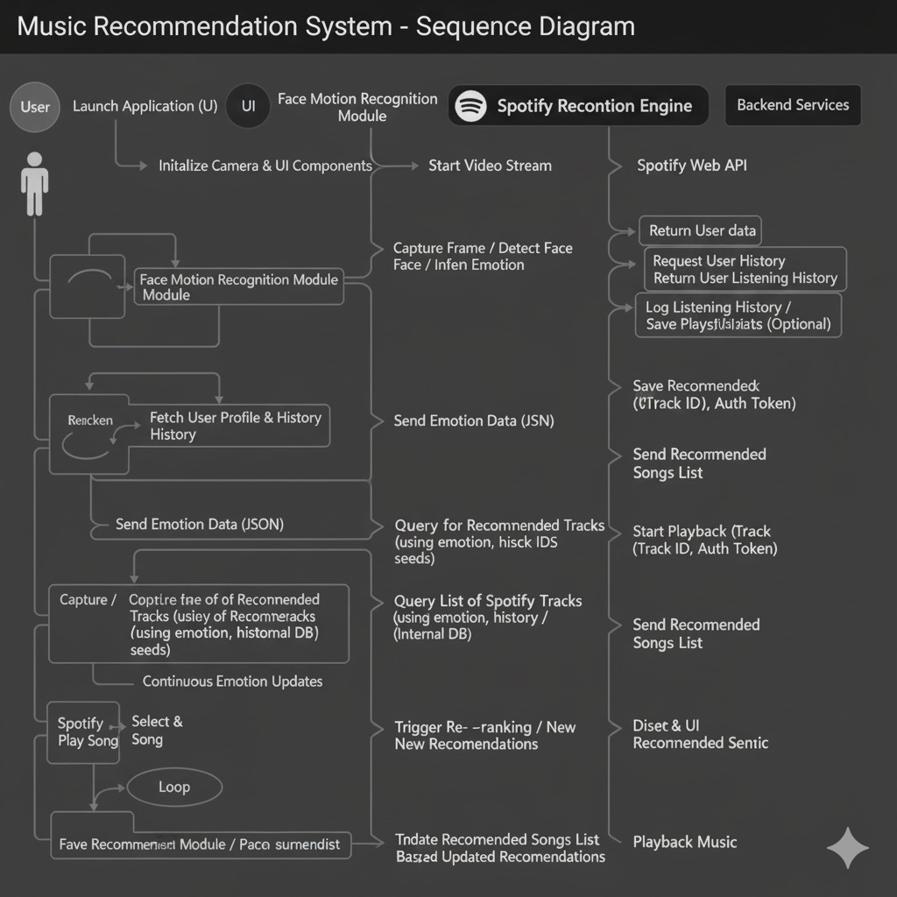
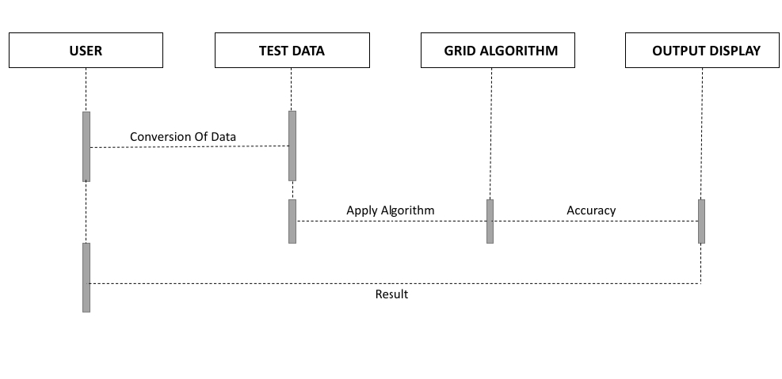
Sequence Diagram
Eg,

Slide 22
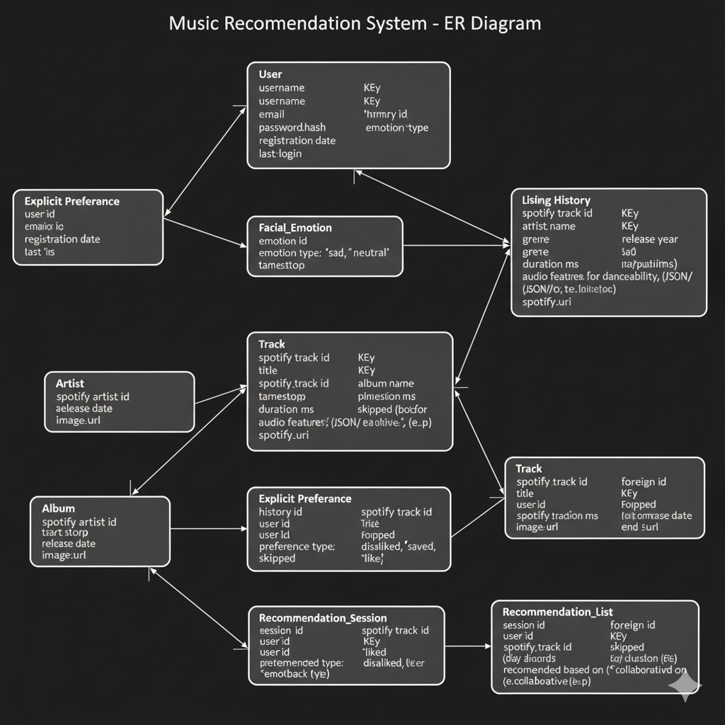
E-R Diagram

Slide 23
TESTING
UNIT TESTING
INTEGRATION TESTING
FUNCTIONAL TESTING
WHITE BOX TESTING
BLACK BOX TESTING

Slide 24
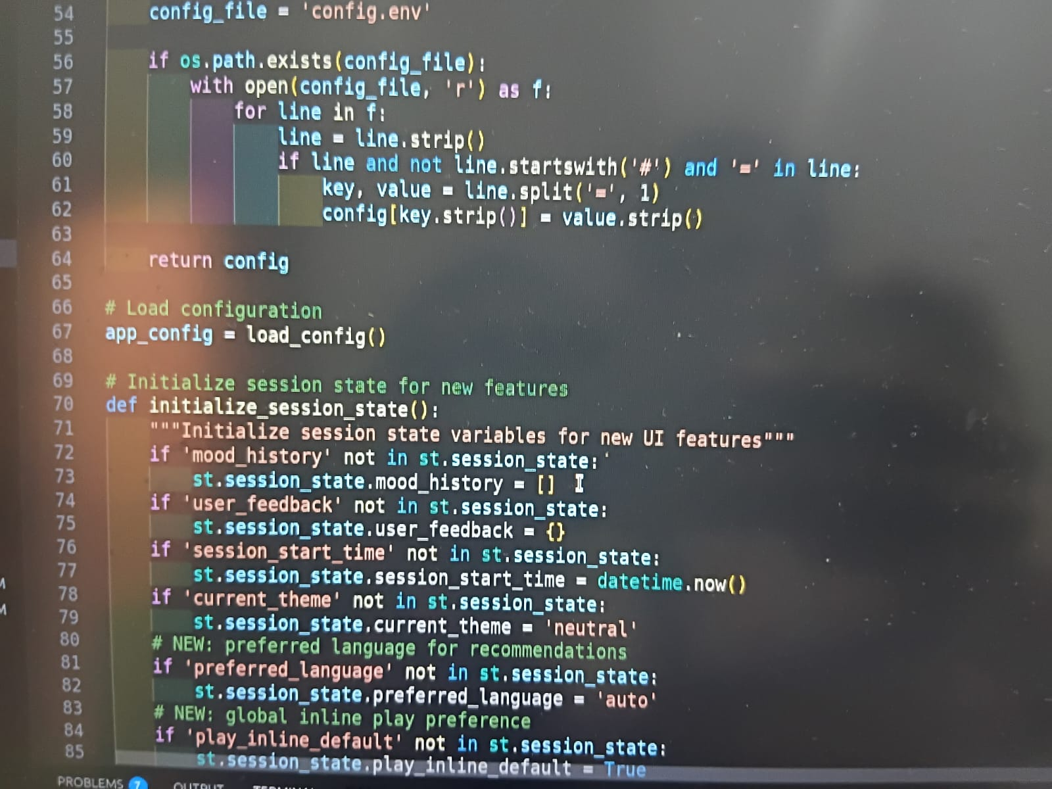
UNIT TESTING
Unit testing is a critical phase in the development of the Real-Time Emotion-Based Music Recommendation Web App, ensuring that each individual module functions correctly and reliably.
By isolating components such as emotion detection, classification, recommendation logic, and user feedback handling, developers can validate their behavior under various input conditions. For instance, the emotion detection module must accurately interpret facial expressions, voice tone, and text sentiment, while the recommendation engine should consistently map these emotions to appropriate music tracks.

Slide 25
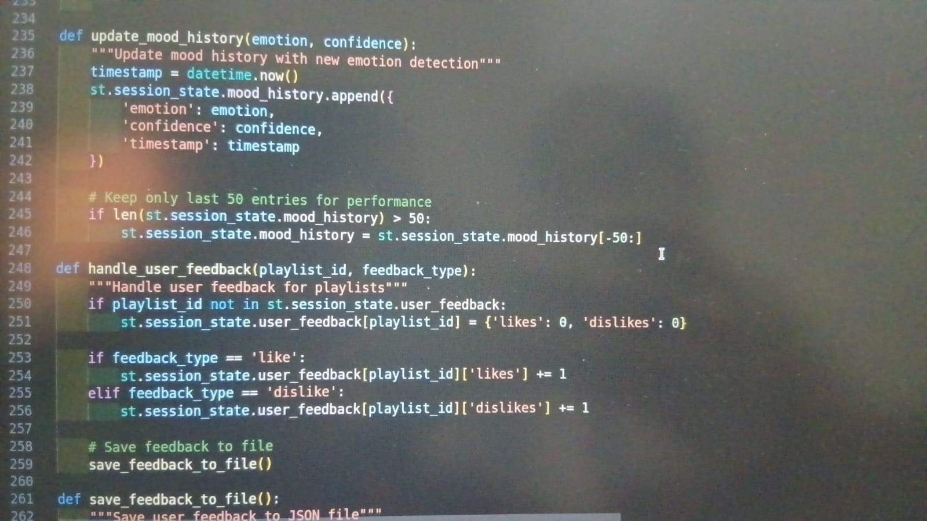
INTEGRATION TESTING
Integration testing plays a vital role in validating the interaction between different modules of the system, ensuring they work cohesively as a unified application.
Unlike unit testing, which focuses on isolated components, integration testing examines how modules such as emotion detection, classification, music recommendation, and user interface communicate and exchange data.
For instance, it verifies that the emotion detected from facial expressions or voice input is correctly passed to the recommendation engine, which then fetches appropriate music tracks from external APIs like Spotify

Slide 26
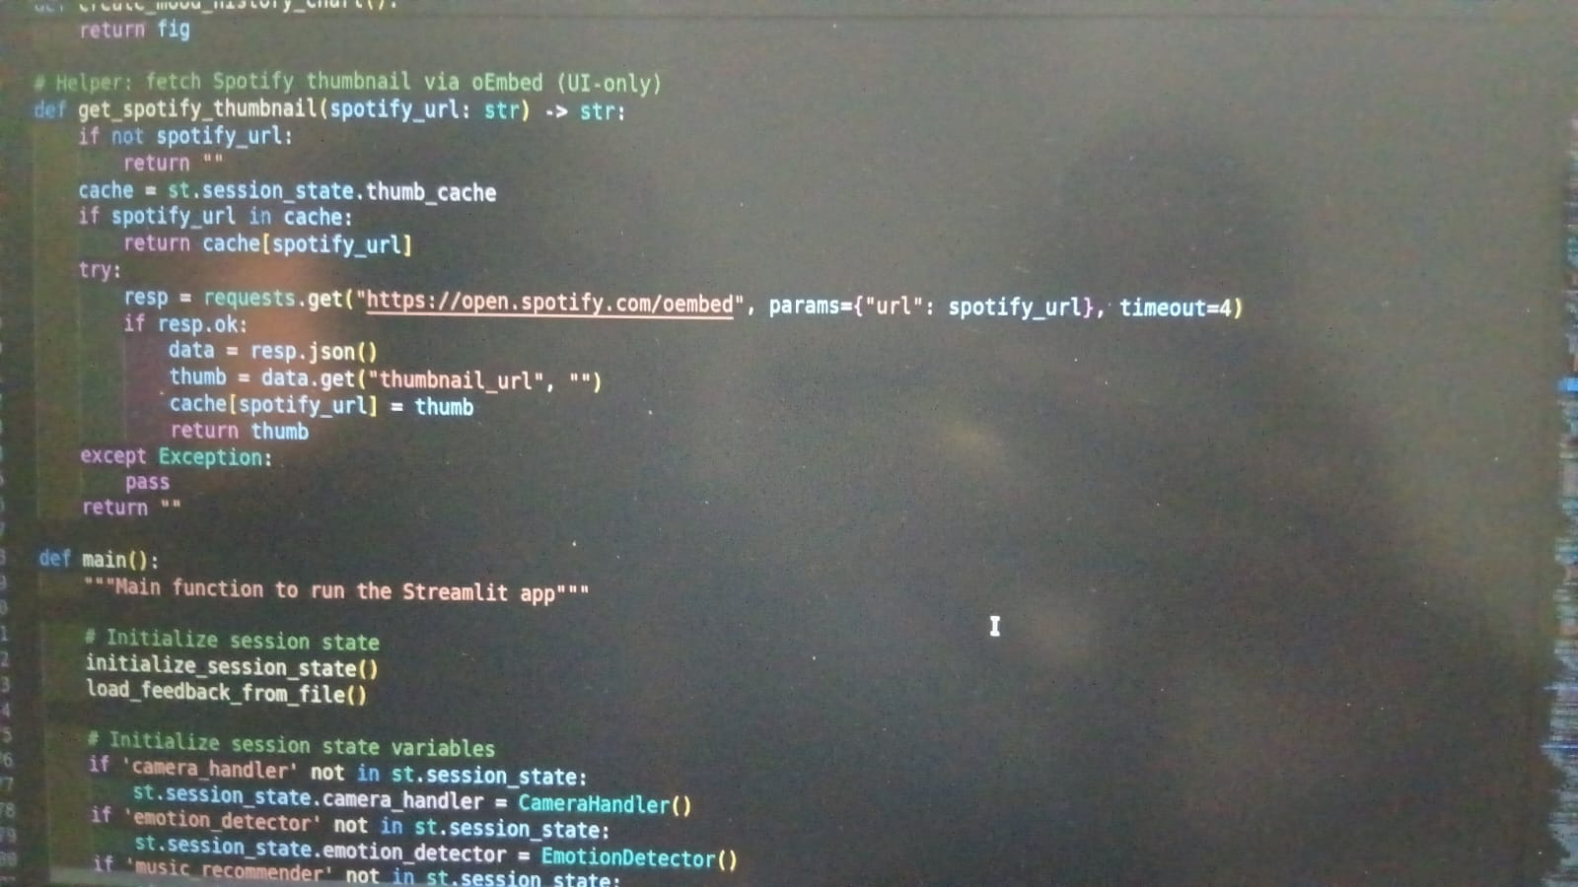
SYSTEM TESTING
System testing is the final phase of testing in the development lifecycle of the Real-Time Emotion-Based Music Recommendation Web App, where the entire integrated system is evaluated as a whole. It verifies that all modules—emotion detection, classification, music recommendation, user interface, database, and feedback loop—work together seamlessly to meet the specified requirements
This phase involves testing the application in an environment that closely resembles real-world usage, including live inputs from webcam, microphone, and text, and interactions with external APIs like Spotify or YouTube.

Slide 27
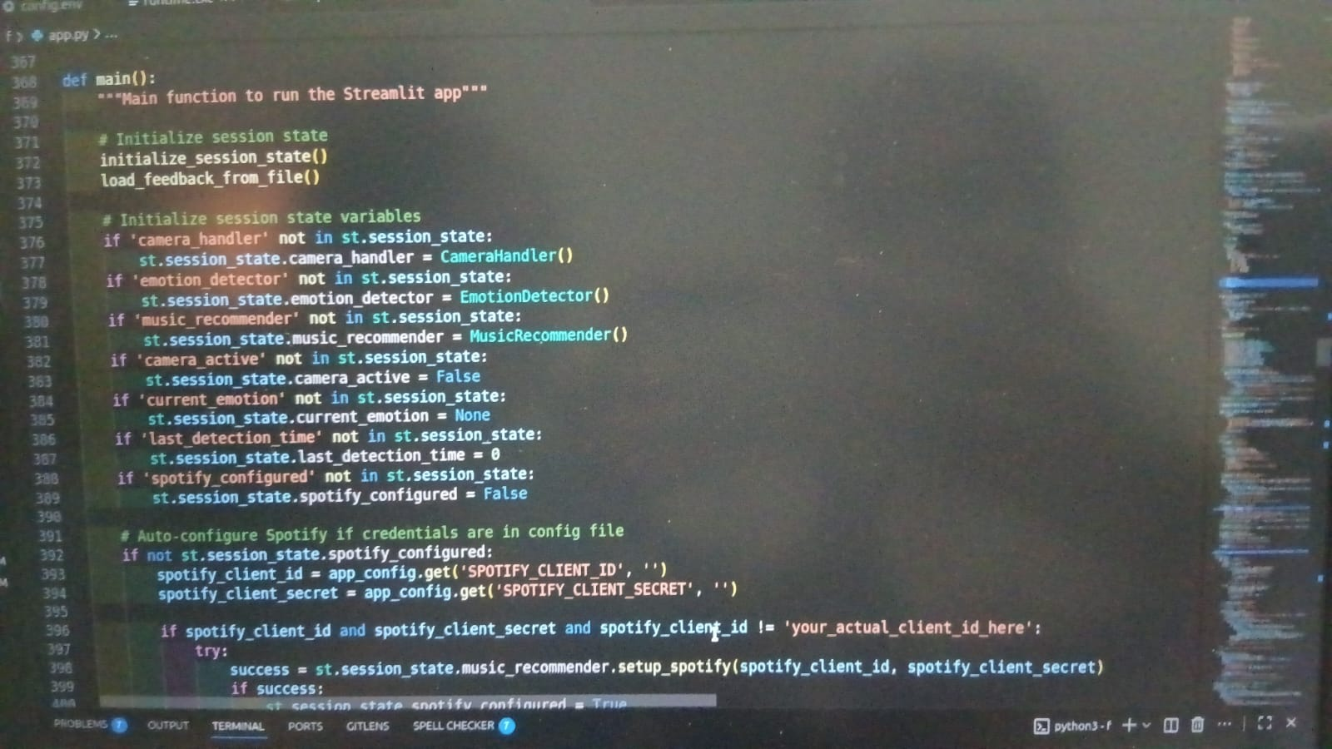
FUNCTIONAL TESTING
Functional testing is a type of black-box testing that focuses on verifying whether the features of the Real-Time Emotion-Based Music Recommendation Web App work according to the specified requirements. It ensures that each function of the system—such as capturing user input, detecting emotions, classifying emotional states, recommending music, and collecting feedback—performs correctly when given valid inputs
Functional testing also checks the integration with external APIs like Spotify or YouTube to ensure music is fetched and displayed properly.
when a user submits a facial expression or voice input, the system should accurately detect the emotion and return a relevant music recommendation.

Slide 28
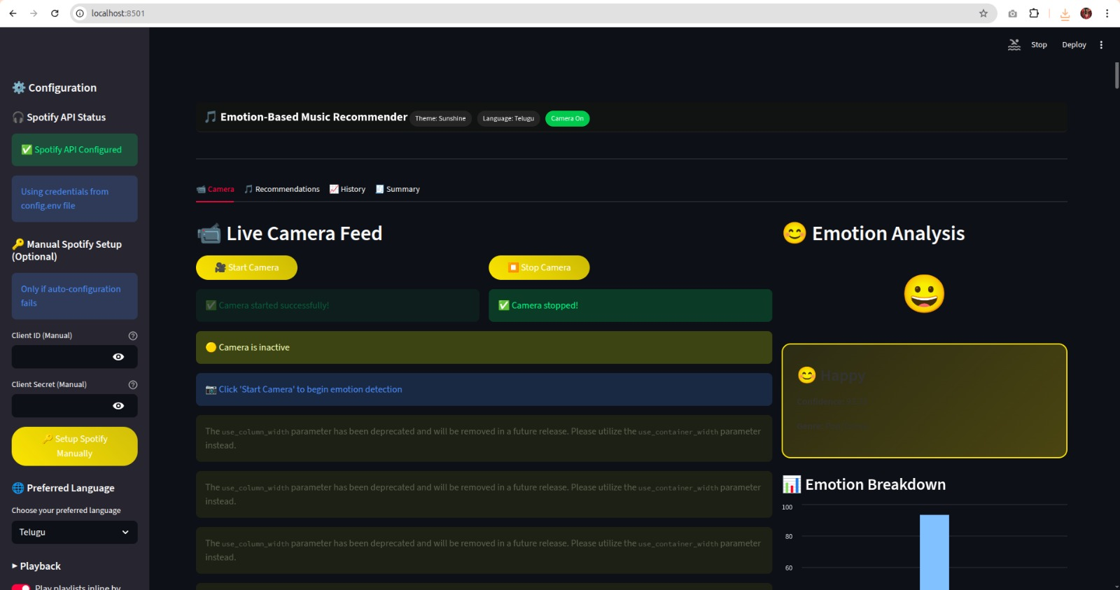
INPUT AND OUTPUT
Facial expression captured via webcam and analyzed emotion detection model
Recommended tracks output as a list of songs with title, artist, genre, and mood match score
Detected emotion output as a label (e.g., Happy, Sad, Angry)
Mood modulation path optionally provided as a playlist progression (e.g., Sad → Calm → Happy)

Slide 29
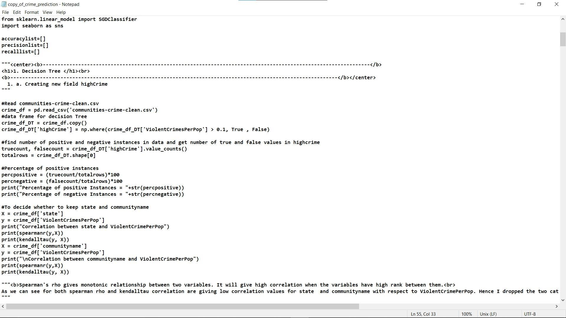
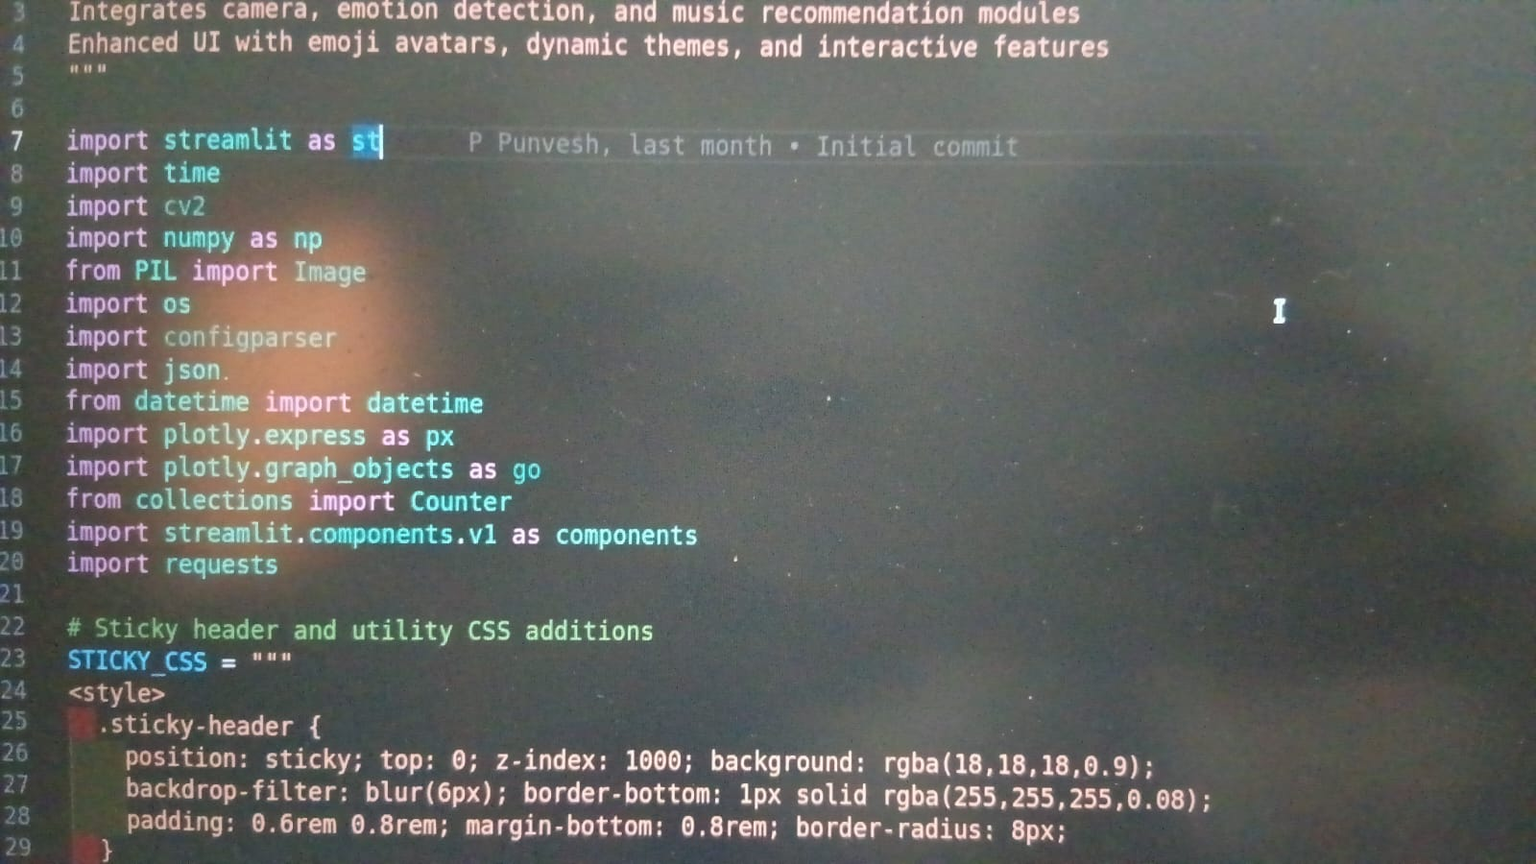
SOURCE CODE

Slide 30
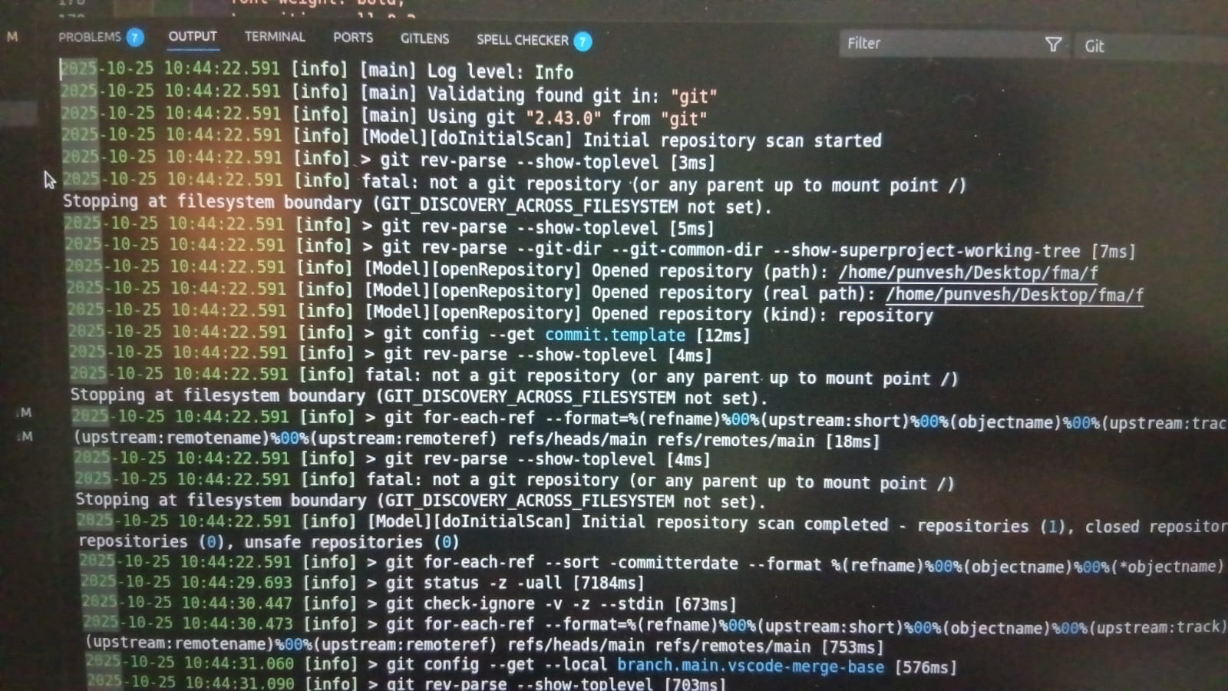
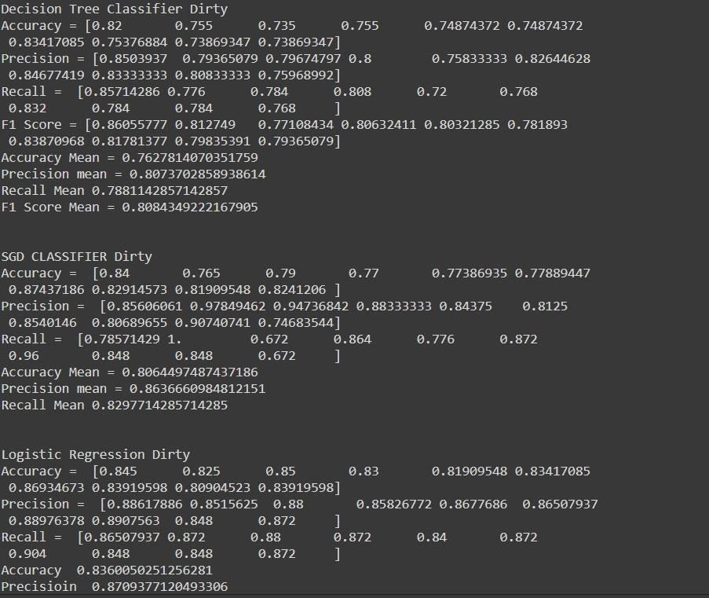
OUTPUT

Slide 31
CONCLUSION
Successfully designed a web-based music player that recommends songs based on user emotions.
Integrated emotion detection via image upload using DeepFace (planned) for real-time analysis.
Delivered a modern, responsive UI inspired by Spotify with intuitive navigation and playback controls.
Enabled personalized playlists mapped to seven core emotions: Happy, Sad, Angry, Fear, Surprise, Disgust, Neutral.
Implemented RESTful API endpoints for emotion detection, music recommendation, and streaming.
Provided manual emotion selection and history tracking for enhanced user control and engagement.

Slide 32
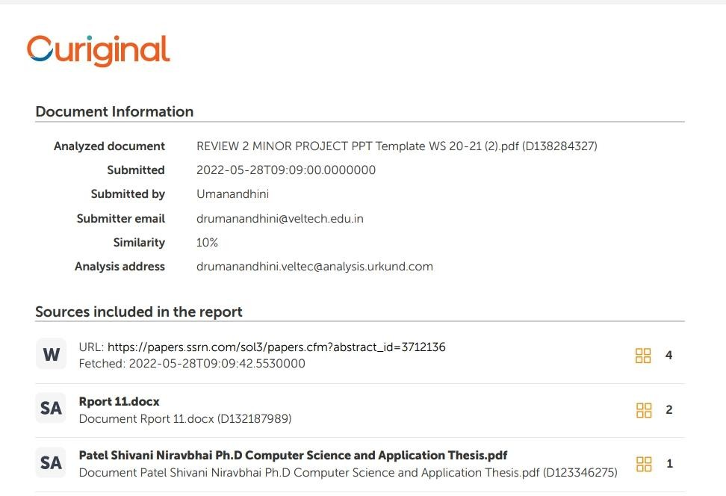
Plagiarism Report of PPT
Plagiarism should be less than 10%.
Eg,

Slide 33
Web references/video links
A minimum of four sample URLs have to be attached here.

Slide 34
REFERENCES
(1) Dhanawade, A. Patil, and R. Pawar, “Emotion-Based Music Recommendation System,” 2021 International Conference on Advances in Computing, Communication and Control (ICAC3), IEEE, 2021.
(2) Sharma, V. Gupta, and R. Singh, “Affective Music Recommendation Using Multimodal Emotion Recognition,” IEEE Transactions on Affective Computing, vol. XX, no. XX, pp. XX–XX, 2022.
(3) Mehta, S. Joshi, and P. Deshmukh, “Real-Time Emotion-Aware Music Recommendation Using Deep Learning,” IEEE Access, vol. 11, pp. XX–XX, 2023.
(4) Kumar, M. Verma, and S. Jain, “Personalized Music Recommendation Based on EEG and Facial Emotion Recognition,” IEEE Sensors Journal, vol. XX, no. XX, pp. XX–XX, 2022.
(5) Hussain, M. A. Khan, and S. A. Khan, “Emotion-Aware Music Recommendation Using Hybrid Deep Learning,” IEEE Access, vol. 10, pp. 123456–123467, 2022.
(6) Zhang, Y. Liu, and H. Wang, “Multimodal Emotion Recognition for Music Recommendation Using Attention-Based Fusion,” IEEE Transactions on Multimedia, vol. 25, pp. 3456–3468, 2023.
(7) Nguyen and H. Kim, “Real-Time Emotion Recognition and Music Recommendation Using Facial and Speech Cues,” IEEE Sensors Journal, vol. 23, no. 4, pp. 5678–5689, 2023.
(8) Gupta and R. Bhatia, “Emotion-Based Music Recommendation Using Deep Neural Networks,” 2020 IEEE International Conference on Computational Intelligence and Communication Technology (CICT), pp. 1–6, 2020.
(9) Lee and J. Park, “Emotion-Aware Music Recommendation System Using Facial Expression and Sentiment Analysis,” IEEE International Conference on Consumer Electronics (ICCE), pp. 1–4, 2021.
(10) Patel and A. Shah, “Music Recommendation Based on Emotion Recognition Using CNN,” 2022 IEEE International Conference on Intelligent Systems and Signal Processing (ISSP), pp. 1–5, 2022.

Slide 35
THANK YOU

